Slide 1
Brown Analytics
Recommendations to Ads Are Us
By : Sagarika Ramesh

Slide 2
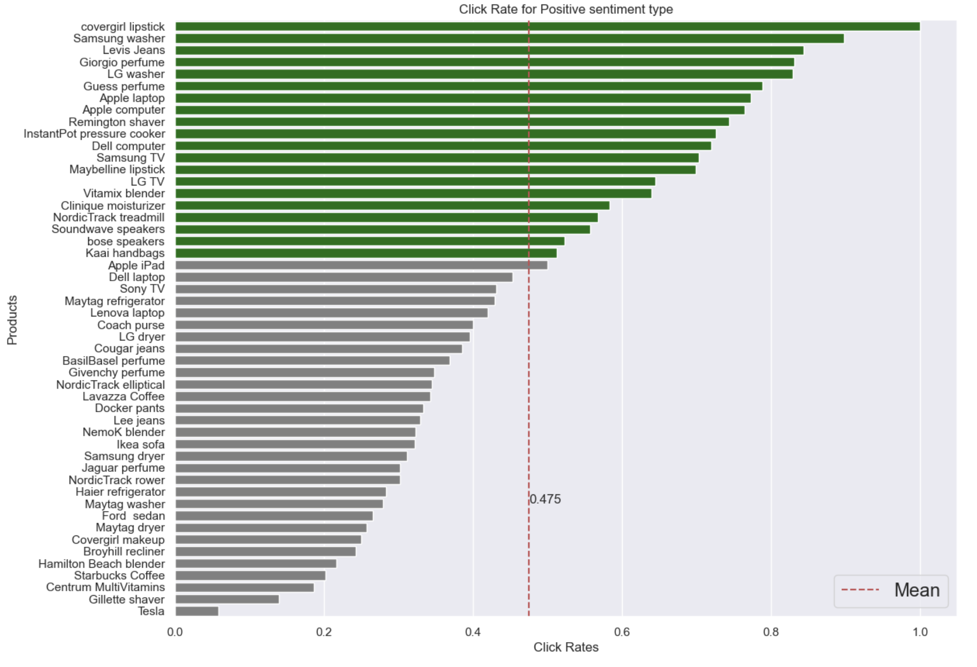
Click rate for Positive sentiment context of the ad.
The bars(horizontal height) of the products are green when the the click rate is more than 0.5 and it is grey when it is less than 0.5
Red dotted line represents the average click rate of all products for a particular sentiment.

Slide 3
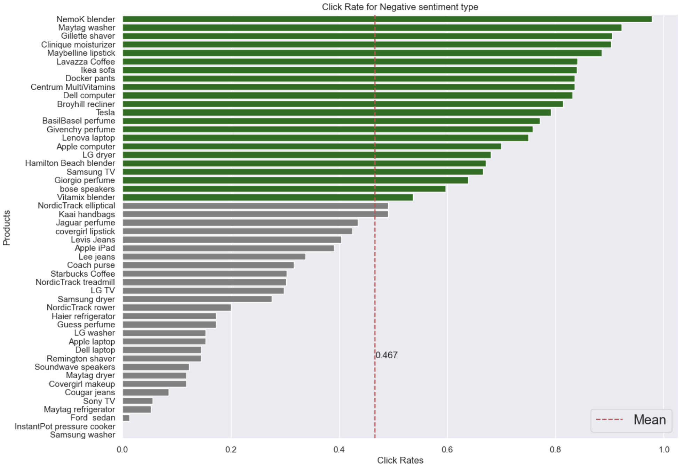
Click rate for Negative sentiment context of the ad.

Slide 4
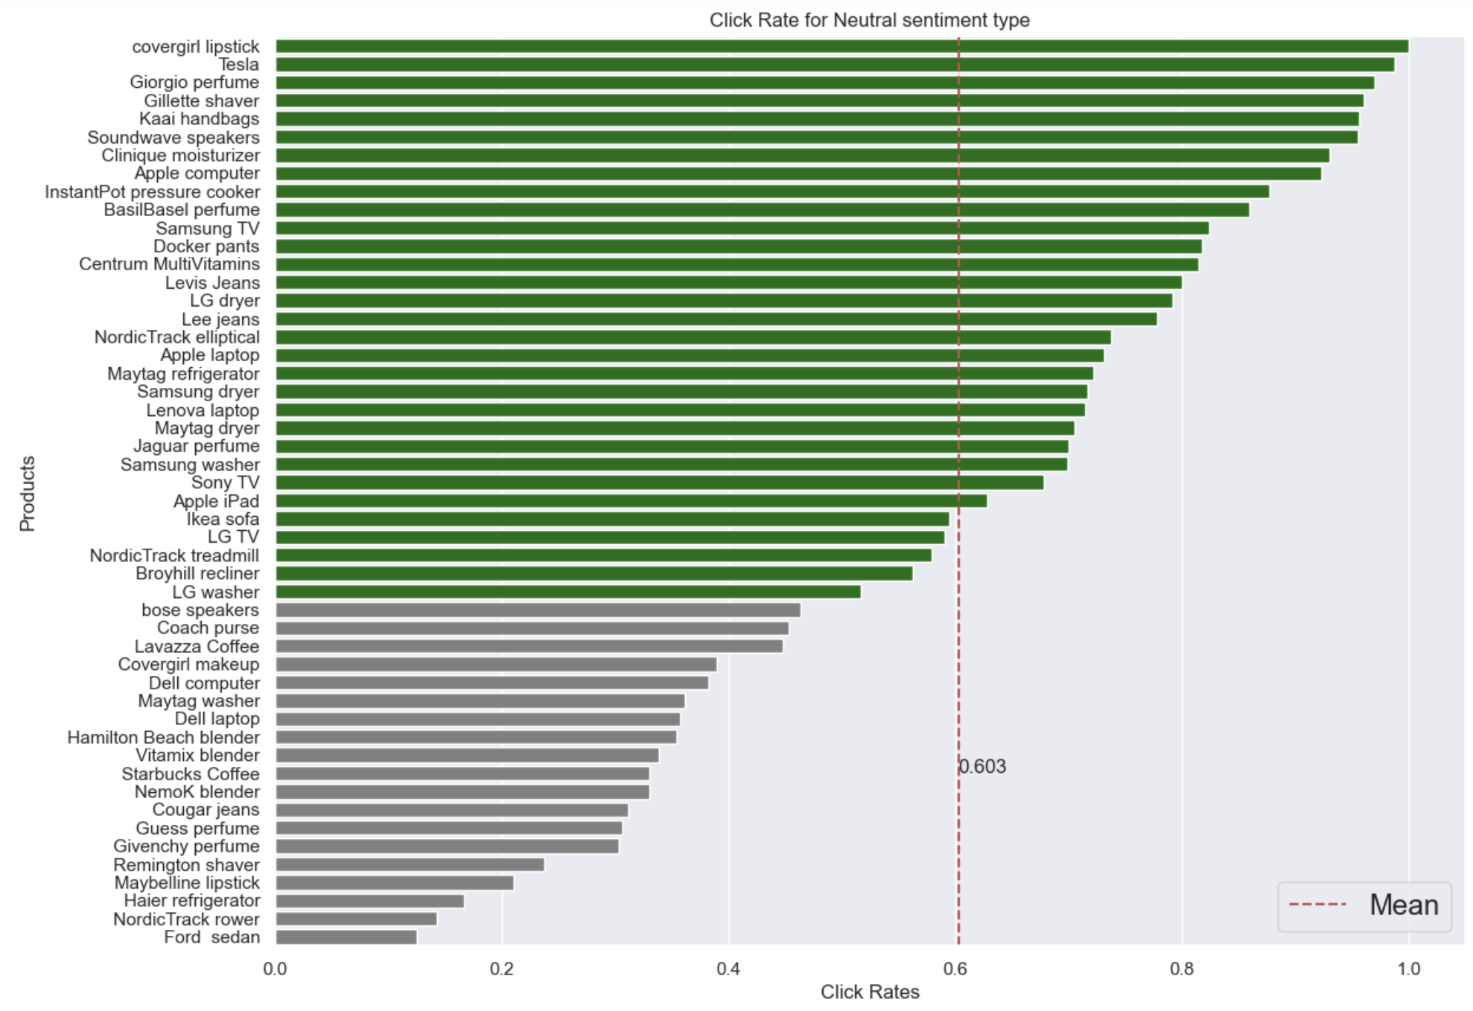
Click rate for Neutral sentiment context of the ad.

Slide 5
Recommendation of Products based on sentiment context of the ad.
Based on the analysis done above, I can say that the mean click rate for all the products is higher when the sentiment type is neutral.
I can make following recommendations:
(1)Covergirl lipstick, samsung washer,Levis Jeans, LG washer,Guess Perfume get more clicks when the sentiment type is positive.
(2)Tesla, Giorgio perfume,Kaai handbags,soundwave speakers, Apple computer, InstantPot Pressure cooker gets more clicks when the sentiment type is neutral.
(3)NemoK Blender,Maytag Washer,Ikea sofa gets more clicks when the sentiment type is negative.

Slide 6
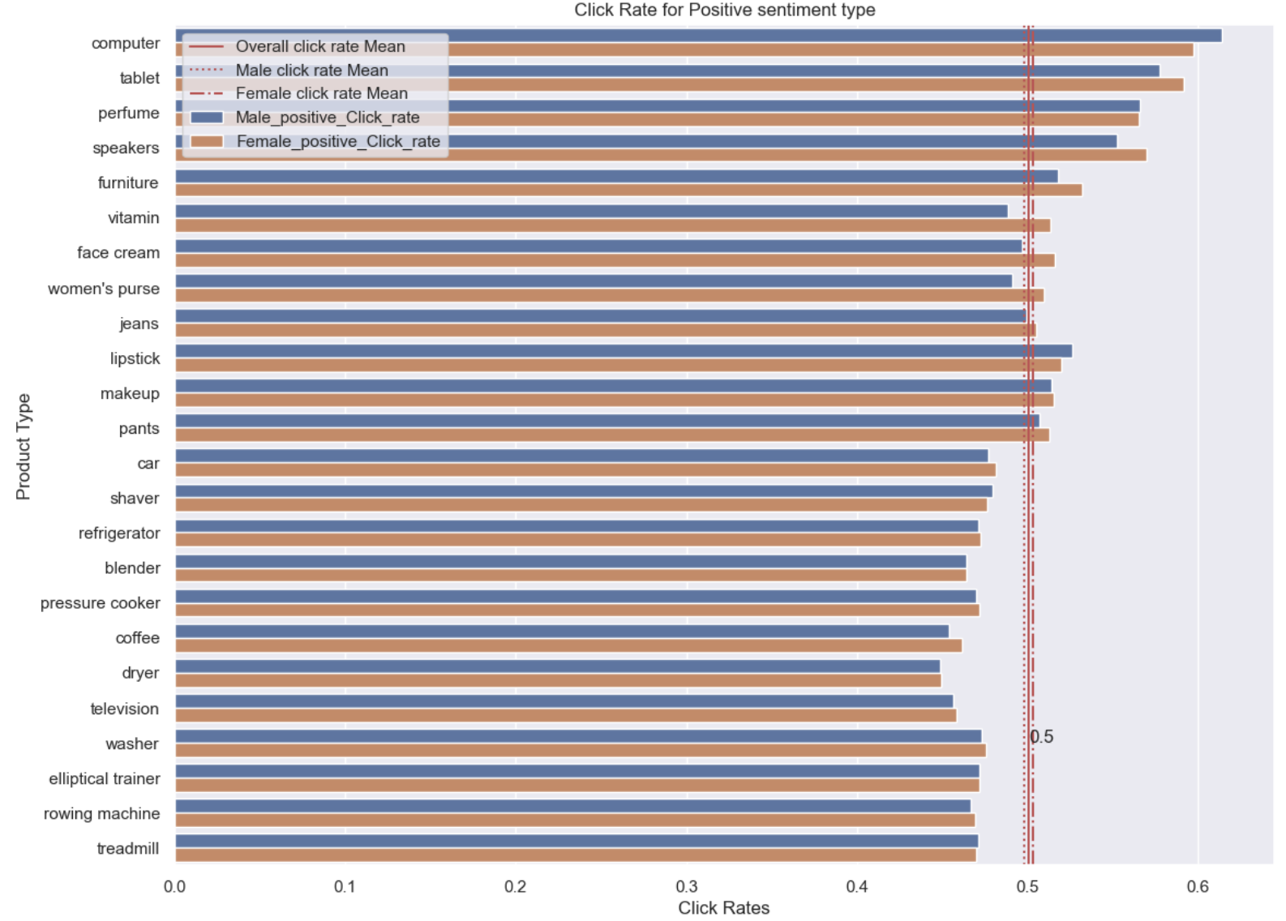
Click rate for Positive sentiment context of the ad by Male and Female viewer.

Slide 7
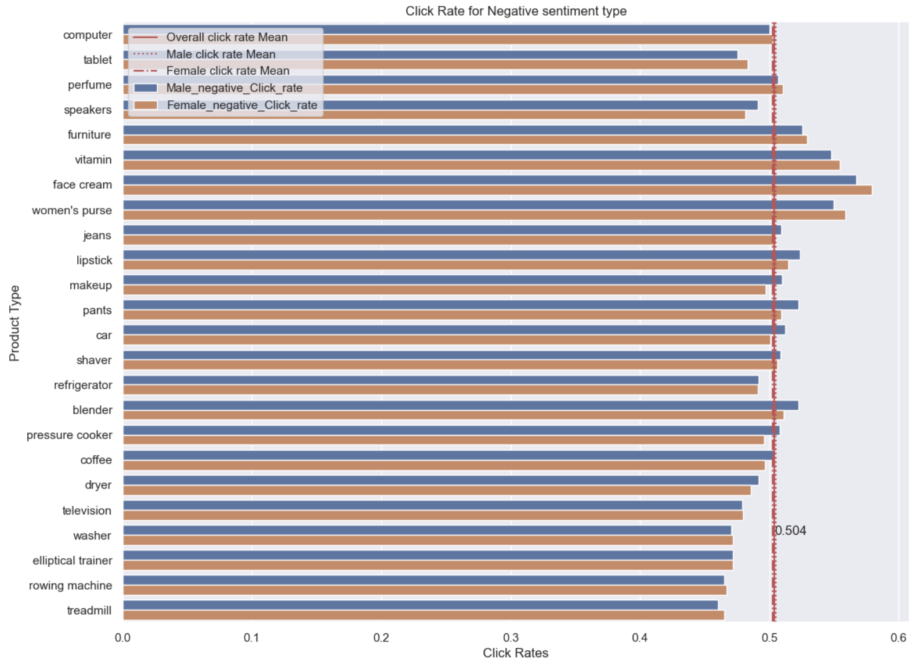
Click rate for Negative sentiment context of the ad by Male and Female viewer.

Slide 8
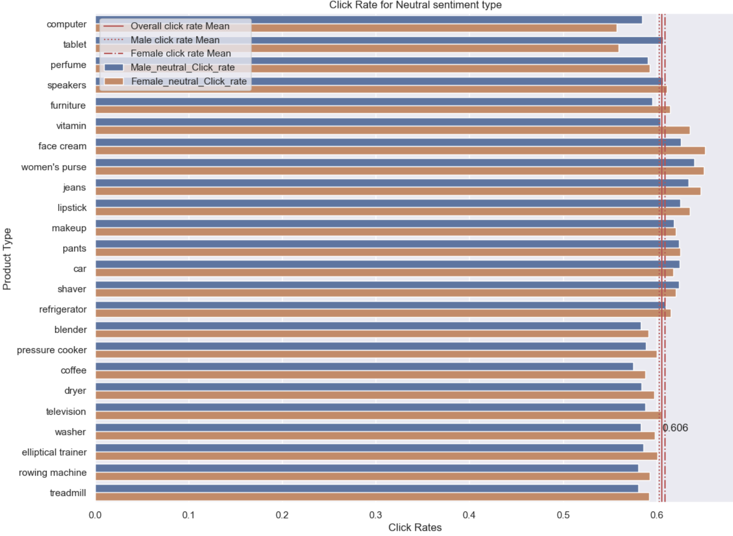
Click rate for Neutral sentiment context of the ad by Male and Female viewer.

Slide 9
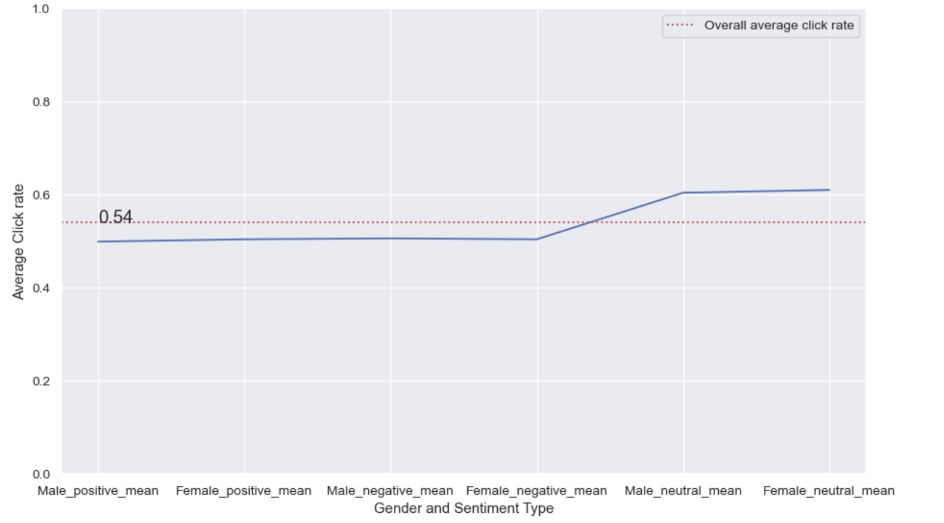
Plot of average click rate by Male and female for each sentiment context of the ad.

Slide 10
Recommendation of Products based on sentiment context of the ad and gender of the viewer.
Based on the analysis done above, I can say that the mean click rate for all the product types is higher when the sentiment type is neutral and gender is female.
From the above analysis we can say that on average click rate by women is slightly more than men on all the sentiment types.
Based on above analysis, I can make following recommendation:
(1)Face cream, vitamins, women's purse, jeans, lipstick, television has higher click rate by women when the sentiment type is neutral.
(2)tablet, car,shaver has higher click rate by men when the sentiment type is neutral.
(3)computer has higher click rate by men when the sentiment is positive.

Slide 11
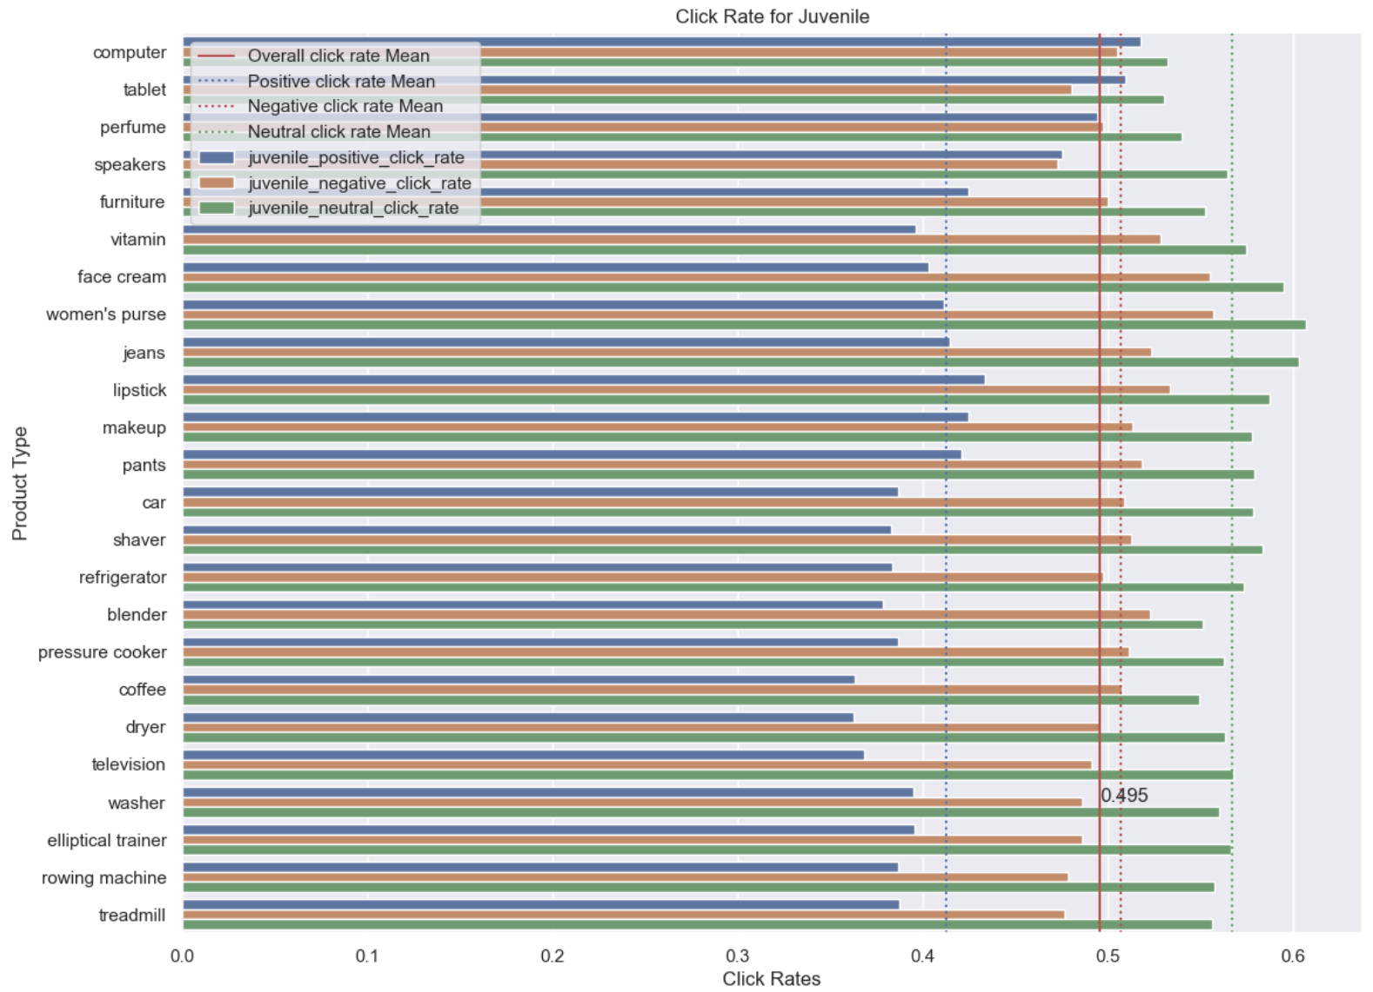
Click rate by Juvenile viewer for each sentiment context of the ad.

Slide 12
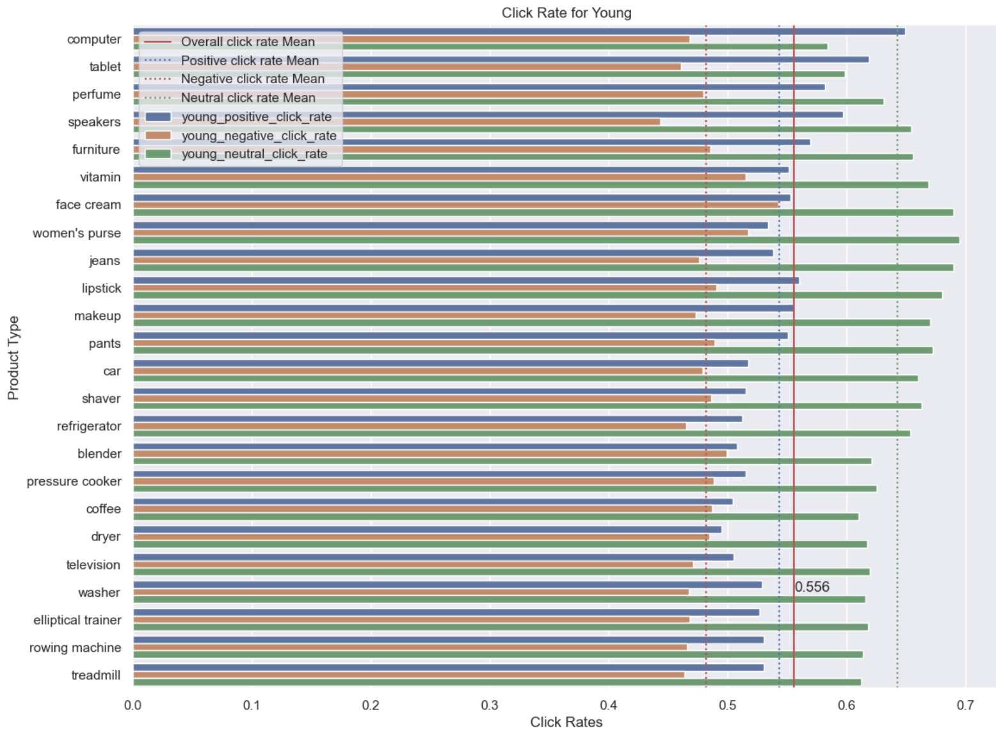
Click rate by Young viewer for each sentiment context of the ad

Slide 13
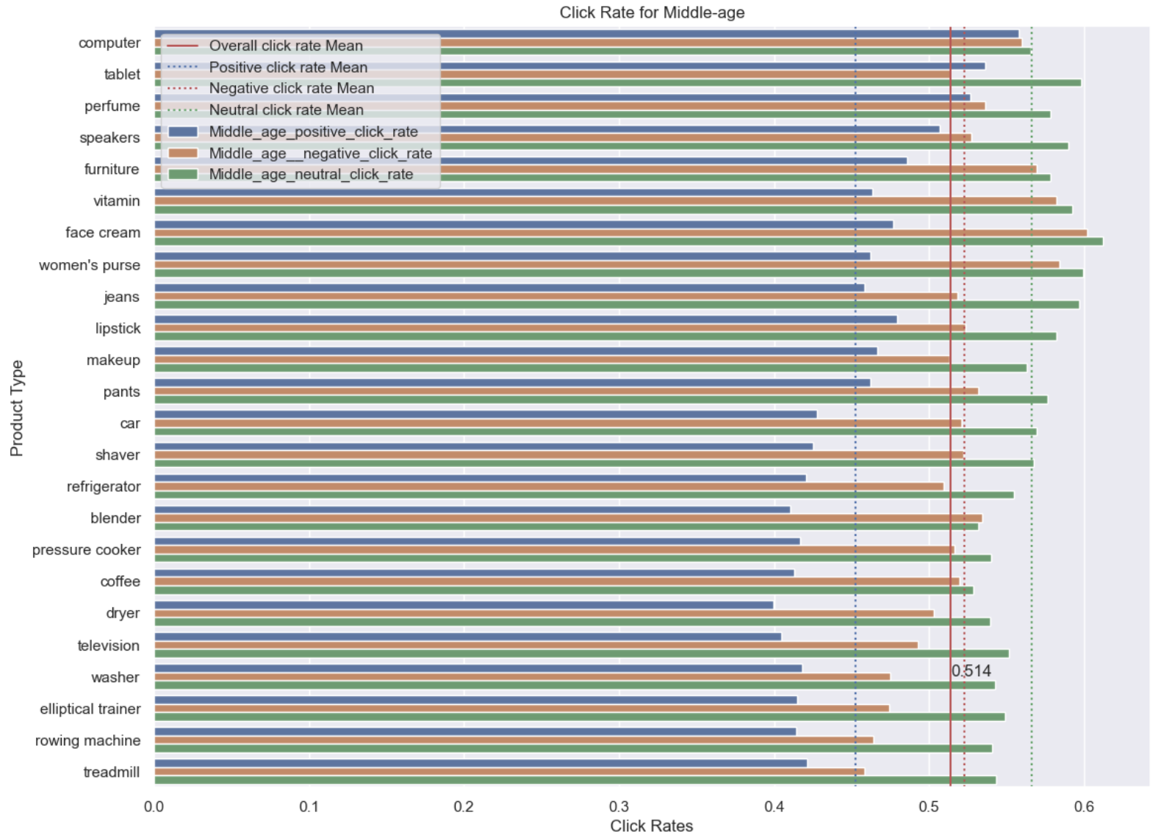
Click rate by Middle-age viewer for each sentiment context of the ad

Slide 14
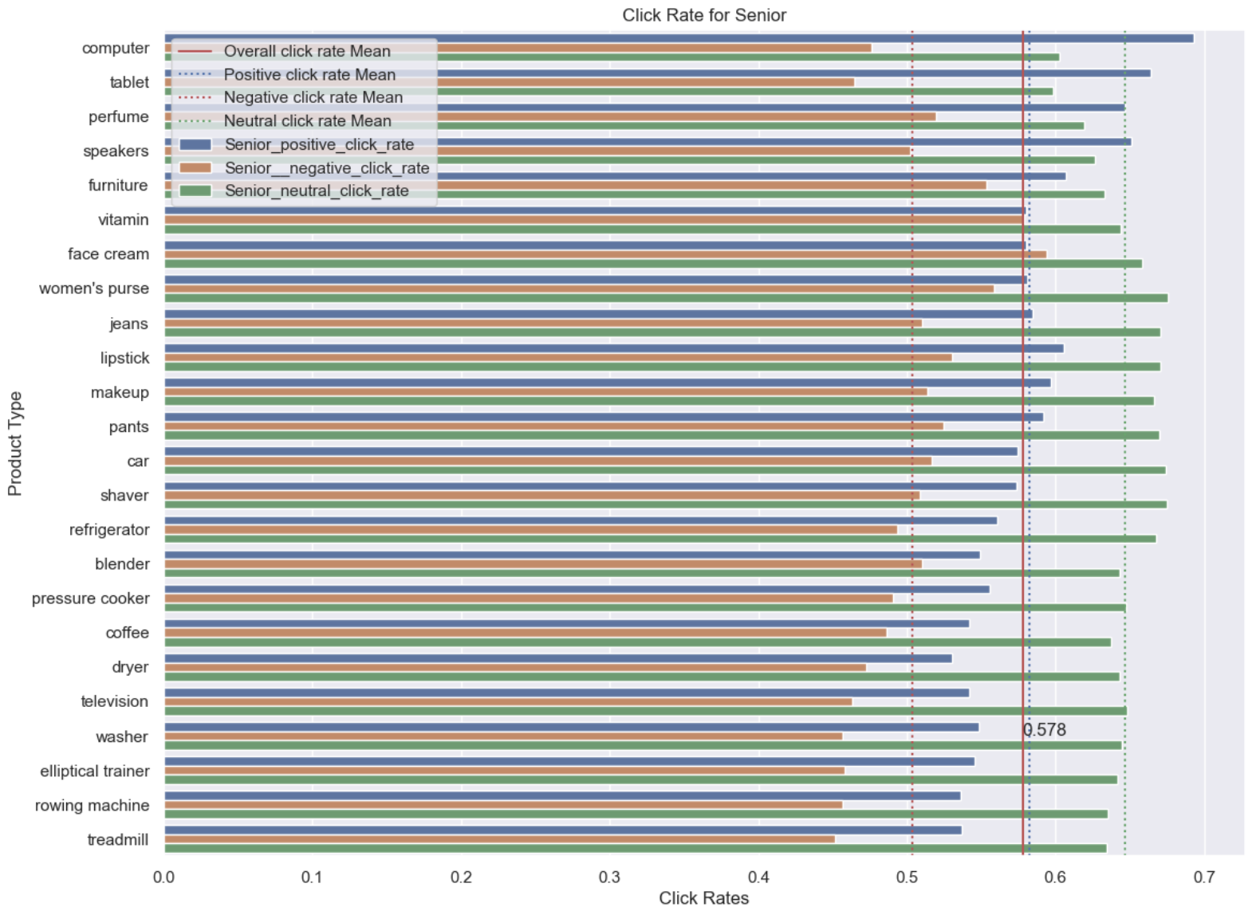
Click rate by Senior viewer for each sentiment context of the ad

Slide 15
Recommendation of Products based on sentiment context of the ad and age-group of the viewer.
From the above analysis we can say that the mean click rate of all the products is higher when the age-group is senior and sentiment type is neutral. And it is lowest when the age-group is juvenile.
We can make the following recommendations:
(1)Treadmill, rowing machine, elliptical trainer, washer, television has higher clicks when the sentiment is neutral and age-group is senior.
(2)Face cream, women's purse, lipstick, jeans, furniture, vitamin has higher clicks when the sentiment is neutral and age-group is young.
(3)Computer, tablet, perfume, speakers has higher clicks when the sentiment is positive and age-group is senior.
​

Slide 16
THANK YOU!

